Slide 1


Personal Fitness
Merit Badge
Troop 344 and 9344
Pemberville, OH

Slide 2
Personal Fitness Merit Badge Requirements
Do the following:
  Before completing requirements 2 through 9, have your health-care practitioner give you a physical examination, using the Scout medical examination form. Explain the following:
    Why physical exams are important
    Why preventive habits (such as exercising regularly) are important in maintaining good health, and how the use of tobacco products, alcohol, and other harmful substances can negatively affect our personal fitness
    Diseases that can be prevented and how
    The seven warning signs of cancer
    The youth risk factors that affect cardiovascular health in adulthood.
  Have a dental examination . Get a statement saying that your teeth have been checked and cared for. Tell how to care for your teeth.

Slide 3
Personal Fitness Merit Badge Requirements
Explain to your merit badge counselor verbally or in writing what personal fitness means to you, including:
  Reasons for being mentally, physically, socially, and spiritually fit
  What it means to be mentally healthy
  What it means to be physically healthy
  What it means to be socially healthy

Slide 4
Personal Fitness Merit Badge Requirements
With your counselor, answer and discuss the following questions:
  Are you living in such a way that your risk of preventable diseases is minimized?
  Are you immunized and vaccinated according to the advice of your healthcare provider and the direction of your parent(s)/guardian(s)?
  Are you free from habits relating to poor nutrition and the use of alcohol, tobacco, drugs, and other practices that could be harmful to your health?
  What are the advantages to getting a full night’s sleep?
  Define a nutritious, balanced diet and why it is important.
  Do you participate in a regular exercise program or recreational activities?
  What are you doing to demonstrate your duty to God?
  Do you spend quality time with your family and friends in social and recreational activities?
  Do you support family activities and efforts to maintain a good home life?

Slide 5
Personal Fitness Merit Badge Requirements
Explain the following about physical fitness:
  The areas of physical fitness
  Your weakest and strongest area of physical fitness
  The need to have a balance in the four areas of physical fitness
  How a program like ScoutStrong can lead to lifelong healthful habits
  How the areas of personal fitness relate to the Scout Law and Scout Oath
Explain the following:
  The importance of good nutrition
  What good nutrition means to you
  How good nutrition is related to the other components of personal fitness
  How to maintain a healthy weight

Slide 6
Personal Fitness Merit Badge Requirements
Before doing requirements 7 and 8, do the following:
  Complete the aerobic fitness, flexibility, and muscular strength tests, as described in the Personal Fitness merit badge pamphlet. Record your results and identify those areas where you feel you need to improve.
  Keep track of what you eat and drink for three days. Identify three healthy eating goals you want to work on.
Outline a comprehensive 12-week physical fitness program using the results of your fitness tests. Be sure your program incorporates the endurance, intensity, and warm-up guidelines discussed in the Personal Fitness merit badge pamphlet. Before beginning your exercises, have the program approved by your counselor and parents.

Slide 7
Personal Fitness Merit Badge Requirements
Complete the physical fitness program you outlined in requirement 7. Keep a log of your fitness program activity (how long you exercised; how far you ran, swam, or biked; how many exercise repetitions you completed; your exercise heart rate; etc.). Keep a log of your weekly healthy eating goals. Repeat the aerobic fitness, muscular strength, and flexibility tests every four weeks and record your results. After the 12th week, repeat all of the required activities in each of the three test categories, record your results, and show improvement in each one. Discuss how well you met your healthy eating goals over these 12 weeks. Discuss the meaning and benefit of your experience, and describe your long-term plans regarding your personal fitness.
Find out about three career opportunities in personal fitness. Pick one and find out the education, training, and experience required for this profession. Discuss what you learned with your counselor, and explain why this profession might interest you.

Slide 8

Requirement 1
Do the following:
  Before completing requirements 2 through 9, have your health-care practitioner give you a physical examination, using the Scout medical examination form. Explain the following:
    Why physical exams are important
    Why preventive habits (such as exercising regularly) are important in maintaining good health, and how the use of tobacco products, alcohol, and other harmful substances can negatively affect our personal fitness
    Diseases that can be prevented and how
    The seven warning signs of cancer
    The youth risk factors that affect cardiovascular health in adulthood.
  Have a dental examination . Get a statement saying that your teeth have been checked and cared for. Tell how to care for your teeth.

Slide 9

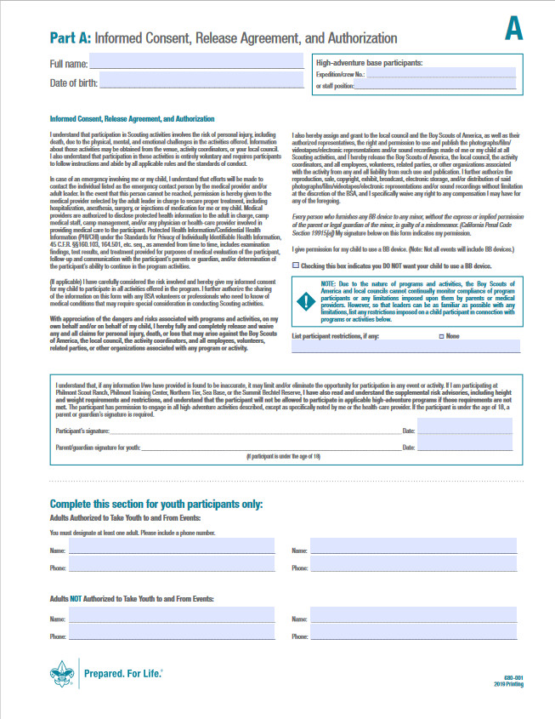
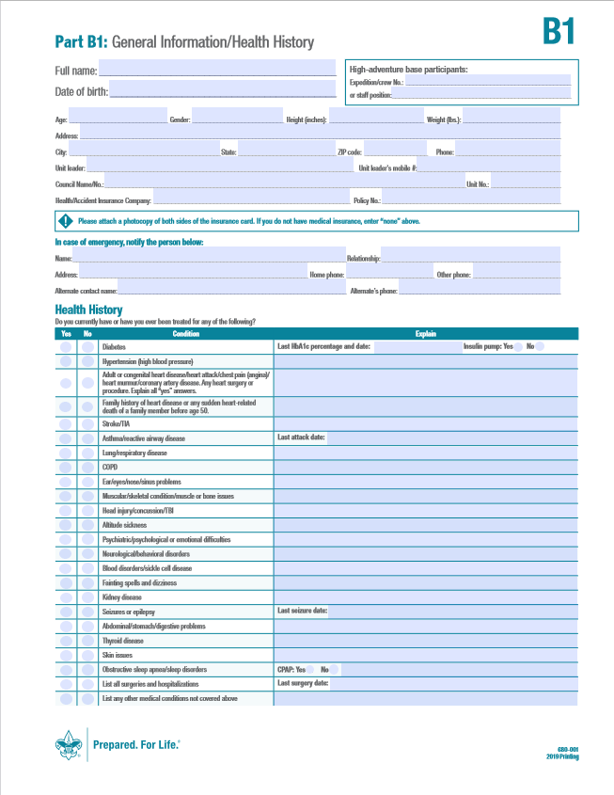
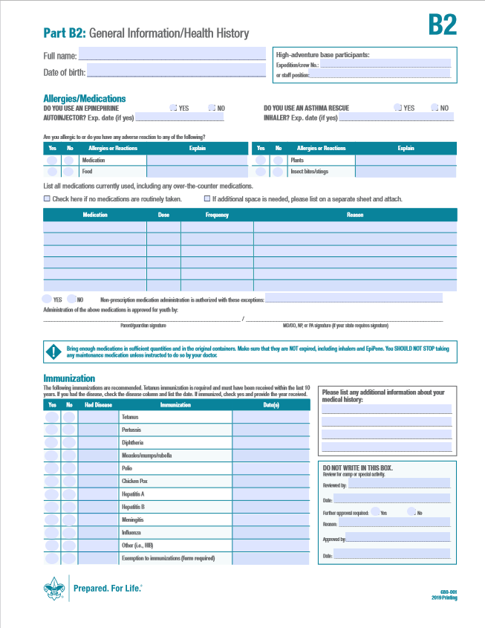
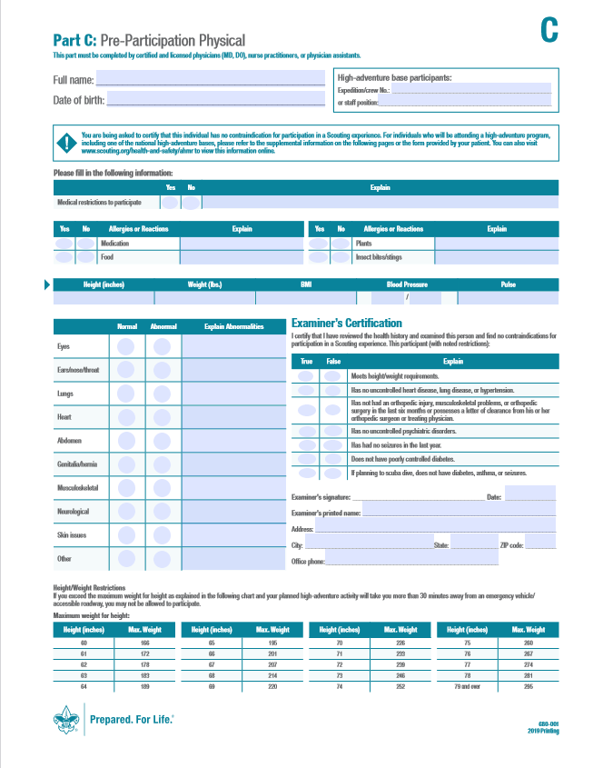
BSA Annual Health and Medical Record
Click on the link to download the most recent version of the BSA Annual Health and Medical Record

Slide 10

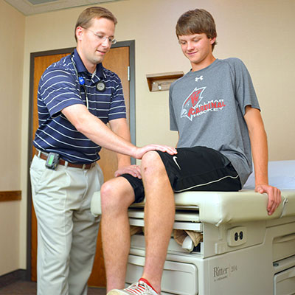
Importance of Physical Exams
Health examinations are necessary to learn about any possible health problems you may not be aware of.
  Health issues that are identified early can often be treated.
Track general health and growth.
Preventative health care reduces the risk for diseases, disabilities, and death.
  Immunizations
  Diet/exercise recommendation
  Screen for chronic illness
Patient education and to provide an opportunity to ask questions about your health.

Slide 11

Preventative Habits to Maintain Health
The three pillars to maintaining health are physical exercise, nutrition, and sleep.
All three are interconnected.
  If you don't sleep well, you may not eat well.
  People get food cravings when they haven’t slept well, and often crave a food with lots of carbohydrates like a cookie.
  When you are tired, the last thing you want to do is exercise.
  Not eating well makes it difficult to keep active throughout the day.

Slide 12

Benefits of Regular Exercising
Exercising 30-60 minutes daily:
  Reduces risk of heart disease.
  Reduces risk of obesity.
  Reduces risk of diabetes.
  Makes you feel and perform better.
Per the CDC, children and adolescents ages 6 through 17 years should do:
  1 hour or more of moderate to vigorous aerobic activity per day.
  Bone strengthening activities (like running or jumping) 3 days/week.
  Muscle building activities (like climbing or doing push ups) 3 days/week.

Slide 13

Benefits of Good Nutrition
Eat a balanced diet appropriate for lifestyle.
Per the CDC, the benefits of healthy eating are:
  May help you live longer.
  Keeps skin, teeth, and eyes healthy.
  Supports muscles.
  Boosts immunity.
  Strengthens bones.
  Lowers risk of heart disease, type 2 diabetes, and some cancers.

Slide 14

Benefits of Regular Sleep
Health benefits of sleep:
  Promotes growth.
  Helps heart health.
  Supports weight management.
  Helps keep your immune system strong.
  Increases attention span.
  Boosts memory and learning.
Hours of sleep based on a child’s age:
  School-aged children: 9-12 hours each night.
  Teenagers: 8-10 hours each night.

Slide 15
Benefits of Regular Sleep
Tips to help you get a better night sleep:
  Avoid late-night snacking, sugar, caffeine, and alcohol.
  Turn off electronics, TVs, and computers two hours before bed. The blue light from these devices causes your brain to stay active. Turning them off a couple hours before bed gives your brain a chance to unwind and get ready for sleep.
  Store all digital devices (e.g., smartphone, tablet, laptop, etc.) in an area of the house other than the bedrooms.
  Sleep in a dark room because light stimulates our brains.
  Use an alarm clock rather than your smartphone or tablet as a wakeup device.
  Keep room temperatures on the cooler side – ideally low to mid-60s.
  Aim for a consistent bedtime routine and sleep schedule to help your body stay on a regular track. Find a good time for you to go to sleep every night and wake up at the same time every morning. It’s also important to keep that same schedule even on the weekends.

Slide 16
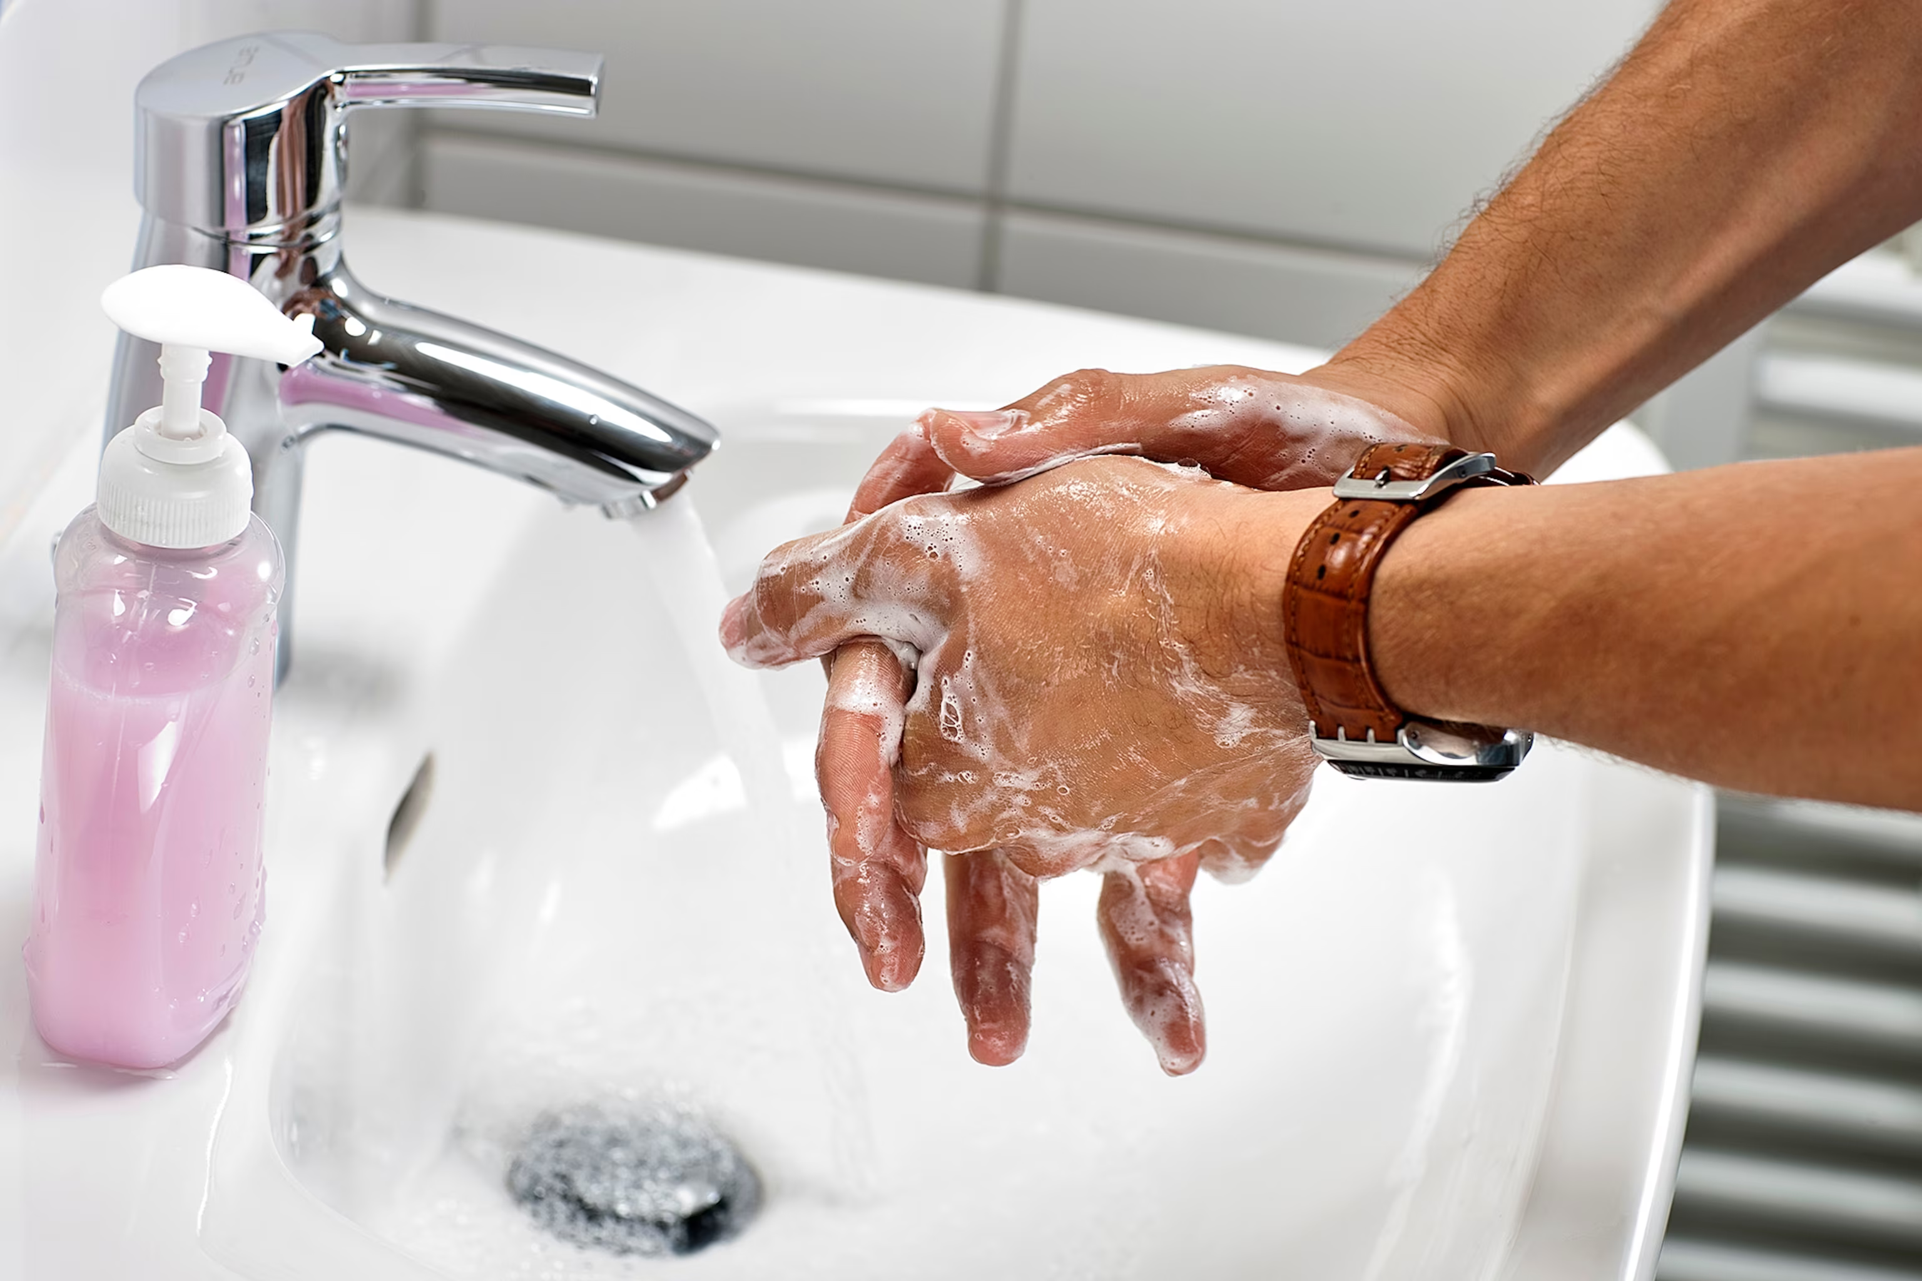
Other Habits for Good Health
Hygiene/Body Care
  Bathe regularly.
  Use deodorant/antiperspirant.
  Wash hands frequently, especially after bathroom use, before handling food, and after handling animals.
  Use sunscreen.
    SPF 30+ daily, especially for your face.
  Avoid close contact with visibly ill people.
  Cover your mouth when sneezing/coughing.
Eyes
  Schedule an annual eye exam.
  Protect your eyes by wearing safety glasses when necessary.
Ears
  Listen to music at reasonable volume.
  Wear ear protection when around noisy equipment and firing ranges.

Slide 17

Use of Tobacco
Smoking triples risk of developing cardiovascular disease
  Heart disease
  Stroke
Smoking increases risk of many cancers:
  Mouth
  Larynx
  Lungs
  Kidneys
  Leukemia
  Many others
Stopping can be extremely difficult
  Nicotine is a highly addictive drug
  Stopping can lead to painful withdrawals
Best never to start tobacco use in the first place

Slide 18

Use of Alcohol
Alcohol is a powerful depressant and impairs:
  Judgement
  Reflexes and coordination
  Vision
  Hearing
Alcohol use among youth associated with:
  Depression and suicide
  Cirrhosis of liver
  Pancreatitis
  Stroke
  Some cancers

Slide 19
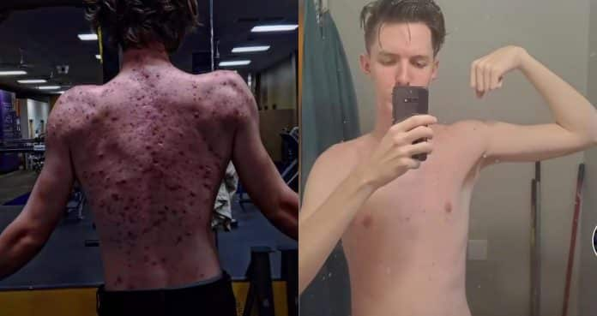
Use of Steroids
Anabolic steroids can cause severe, long-lasting, and in some cases, irreversible damage.
They can lead to:
  Early heart attacks.
  Strokes.
  Liver damage and tumors.
  Kidney failure.
  An increase in acne.
  Rapid weight gain.
  Blood clotting disorders.
  Psychiatric problems.
  Stopping steroid use can cause depression, often leading to resumption of use.
“Roid Rage” is the term for the explosive, out-of-control aggressiveness associated with steroid use.

Slide 20

Use of Amphetamines
Amphetamines are also known as uppers.
  Are highly addictive.
  Cause feelings of power and assertiveness.
  Impair judgement.
  Distort view of reality.
Amphetamines use presents a significant health risk.
  Can cause life threatening weight loss.
  Damages blood vessels leading to strokes and heart attacks.
  Uncontrollable and abnormal movement of the face and jaw.
  Convulsions.
  Hallucinations.
  Mental disorders such as paranoia and delusions similar to schizophrenia.

Slide 21
Use of Marijuana
Marijuana use beginning in teen years or younger may affect brain development.
Negative effects of teen marijuana use include:
  Difficulty thinking and problem-solving.
  Problems with memory and learning.
  Reduced coordination.
  Difficulty maintaining attention.
  Problems with school and social life.
Marijuana use has been linked to depression and social anxiety.
Driving while impaired by marijuana is dangerous and illegal.
Potential for addiction – Trying but failing to quit using marijuana or giving up important activities with friends and family in favor of using marijuana.

Slide 22

Use of Other Drugs
Cocaine and crack, heroin, inhalants, and LSD.
Overdoses are common and can result in serious illness, disability, or death.
Negative affects of drug use:
  Addiction.
  Nightmares and severe mental disturbances.
  Brain damage.
  Heart attack.

Slide 23
Disease Prevention
Communicable diseases can be greatly reduced by keeping your hands clean.
Cover your mouth when you sneeze or cough.
Keep your distance from people who are sick.
Good eating habits improve your body’s defenses against cold and flu as well as more serious diseases such as heart disease.
Learn to listen to your body and recognize its warning signs.
  Heed the warning signs and consult your health-care provider for proper treatment when symptoms appear.
Develop good health habits and avoid or change bad habits like smoking, drinking alcohol, and using drugs.
  These bad habits can harm your body in ways that may not show up for years.
Many diseases can be prevented by immunization.

Slide 24

Immunizations
Having immunization shots during childhood minimizes your risk of getting many diseases, some which can be life threatening. These include:
  Chicken pox
  Diphtheria
  Hepatitis
  Human papillomavirus
  Pertussis
  Tetanus
  Measles
  Meningitis
  Mumps
  Polio
  Rubella
The ages at which children and young adults should receive vaccines and boosters are shown in the chart on the next page.

Slide 25
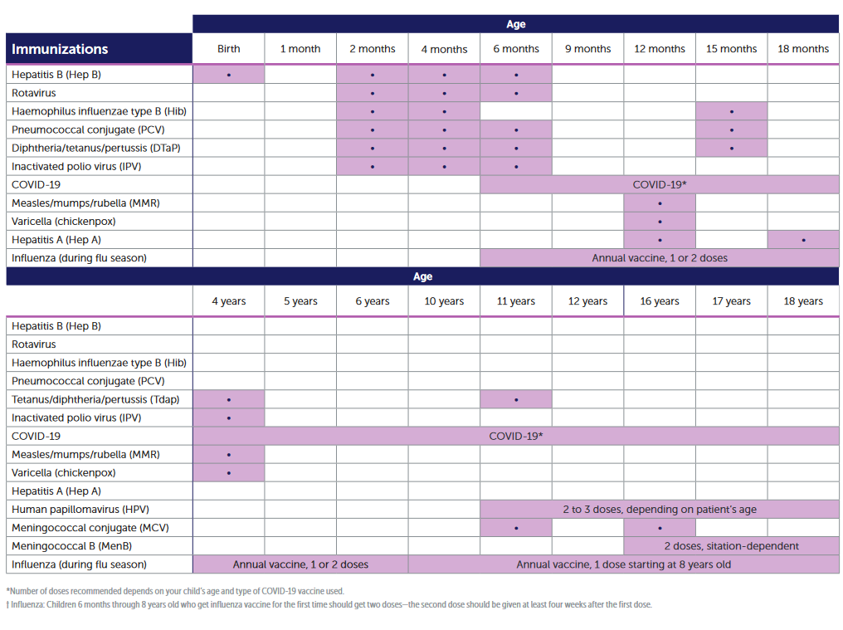
Disease Prevention

Slide 26
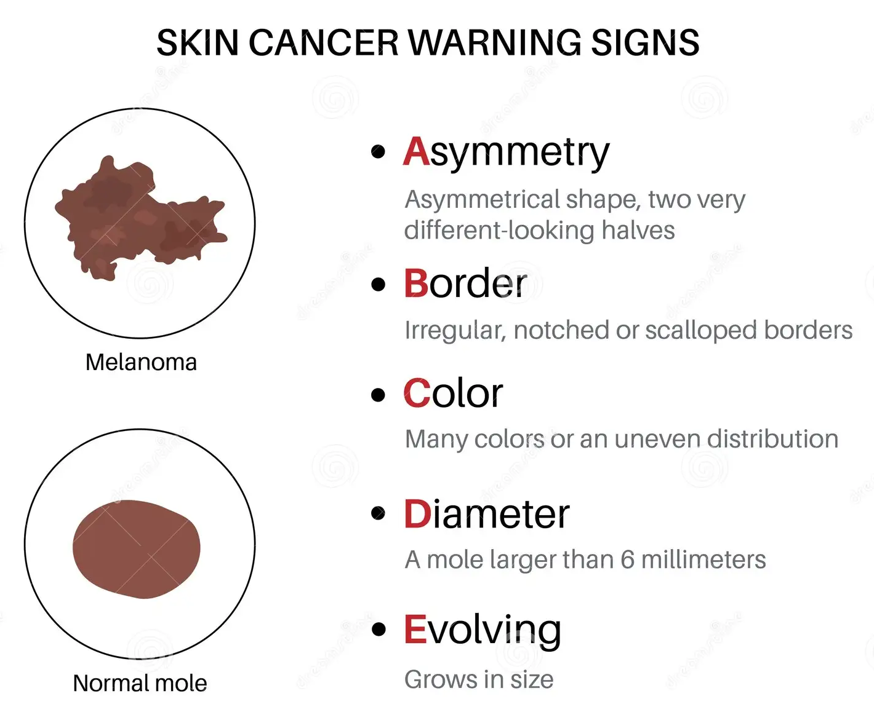
Warning Signs of Cancer
7 warning signs of cancer:
  Change in bowel or bladder habits (colorectal).
  Sore that does NOT heal on skin or in mouth.
  Unusual bleeding or discharge from rectum/bladder (colorectal, prostate, bladder).
  Thickening of breast tissue, new lump in breast or lump in testes.
  Indigestion or trouble swallowing (mouth, throat, esophagus, stomach).
  Changes to moles or warts (skin).
  Nagging cough or hoarseness that persists for 4-6 weeks (lung or throat).

Slide 27

Youth Risk Factors for Cardiovascular Disease
Youth risk factors that affect cardiovascular fitness in adulthood.
  Obesity*
  Gender (males at higher risk)
  High blood pressure**
  High cholesterol**
  Diabetes
  Smoking*
  Lack of exercise*
  Family history of heart disease
*Modifiable risk
**Possibly modifiable risk with diet/exercise, may require a prescription

Slide 28

Dental Examination
Have a dental examination.
Get a statement from you’re a parent/guardian saying that your teeth have been checked and cared for.

Slide 29
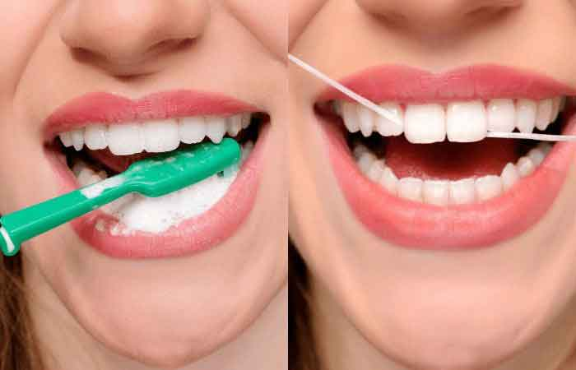
How to Care for Your Teeth
Brush your teeth twice a day with fluoride toothpaste.
Floss teeth once per day.
Cut down on sugar.
Have regular dental checkups (every 6 months).
Braces, if necessary, to straighten your bite to prevent unnecessary wear and tear on teeth.

Slide 30

Requirement 2
Explain to your merit badge counselor verbally or in writing what personal fitness means to you, including:
  Reasons for being mentally, physically, socially, and spiritually fit
  What it means to be mentally healthy
  What it means to be physically healthy
  What it means to be socially healthy

Slide 31
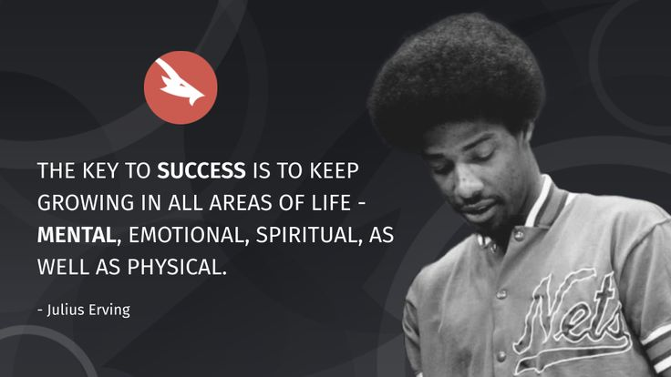
Reasons for being mentally, physically, socially, and spiritually fit
All areas of personal fitness work together, interacting and influencing one another.
  Exercise, diet, sleep, family life, and religious involvement impact mental and emotional fitness and vice versa.
A high level of fitness in one area can boost another area while a low level of fitness in one area can limit your accomplishments in the other areas.
All types of fitness improve quality of life.
Fitness provides energy to do the activities we enjoy.
Developing a healthy fitness pattern continues throughout life.

Slide 32

Mentally Healthy
What Does It Mean to Be Mentally Healthy?
  Being able to express your feelings and emotions.
  Not being controlled by anxiety.
  Learning to communicate.
  Understanding that ups and downs in life are temporary.

Slide 33
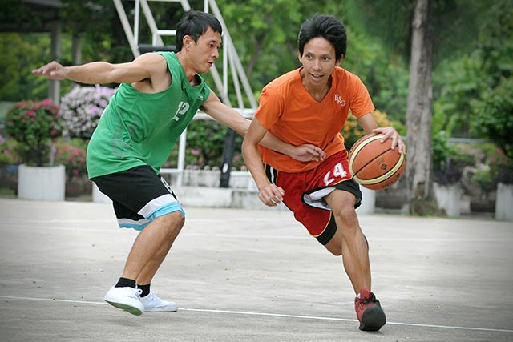
Physically Healthy
What Does It Mean to Be Physically Healthy?
  Regular exercise.
  Balanced diet.
  Preventing disease through good habits and immunizations.
  Maintaining a healthy weight.
  Refusing to use alcohol, tobacco, and other drugs.
  Getting enough sleep.

Slide 34

Socially Healthy
What Does It Mean to Be Socially Healthy?
  Having good friends you can talk to and trust.
  Developing social skills.
    Being a good listener.
    Accepting of other for who they are.
  Able to handle peer pressure.
  Knowing your life priorities.
  Growing in confidence.

Slide 35

Tips for handling negative peer pressure
Be confident in yourself and know that it is okay to say “No”.
Consider the consequences or the outcome of what someone is pressuring you to do.
Listen to what your gut is telling you.
Hang out with people who are similar to you; who have the same values as you do.
Make decisions based upon what is best for you regardless of what others are telling you to do.
Enlist the help of a trusted adult if you are in a situation involving peer pressure that you are unsure about.

Slide 36

Spiritually Fit
What does it mean to be Spiritually Fit?
  Being “morally straight.”
  Exhibiting ethical behavior.
    Governed by the values of your religion/spiritual tenets, family, community.
    Doing the right thing even when no one is watching.

Slide 37
Requirement 3
With your counselor, answer and discuss the following questions:
  Are you living in such a way that your risk of preventable diseases is minimized?
  Are you immunized and vaccinated according to the advice of your healthcare provider and the direction of your parent(s)/guardian(s)?
  Are you free from habits relating to poor nutrition and the use of alcohol, tobacco, drugs, and other practices that could be harmful to your health?
  What are the advantages to getting a full night’s sleep?
  Define a nutritious, balanced diet and why it is important.
  Do you participate in a regular exercise program or recreational activities?
  What are you doing to demonstrate your duty to God?
  Do you spend quality time with your family and friends in social and recreational activities?
  Do you support family activities and efforts to maintain a good home life?

Slide 38



Minimizing Communicable Diseases
Healthy habits prevent germs and infectious diseases from spreading.
  Handle and Prepare Food Safely.
  Wash Hands Often.
  Clean and Disinfect Commonly Used Surfaces.
  Cough and Sneeze into a Tissue or Your Sleeve.
  Don’t Share Personal Items.
  Get Vaccinated.
  Avoid Touching Wild Animals.
  Stay Home When Sick.

Slide 39
Minimizing Non-Communicable Diseases
Maintain a healthy lifestyle through:
  Getting recommended vaccinations – Vaccines can prevent many infectious diseases.
  Avoiding tobacco and alcohol – Avoiding alcohol helps prevent depression, chronic liver diseases and motor vehicular injuries. Chewing and smoking tobacco contribute to cancer, chronic lung diseases, heart diseases and strokes.
  Adequate Sleep – 6 to 8 hours of sound sleep is a must for a healthy body to function. Ongoing sleep deficiency is linked to obesity and an increased risk of heart disease, kidney disease, high blood pressure, diabetes, and stroke.
  Healthy Diet – A healthy and balanced diet is vital for overall body health. Avoid canned food and excessive salt to prevent hypertension.
  Regular Exercise – Physical activity is one of the best ways you can improve your health now and in the future. Obesity is associated with coronary heart disease, type 2 diabetes, asthma, stroke and even some cancers.
  Mental Relaxation – Meditation, exercise, and relaxation play a role in reducing anxiety and depression. This will have a positive impact on reducing hypertension, heart attacks and diabetes in the longer run.

Slide 40
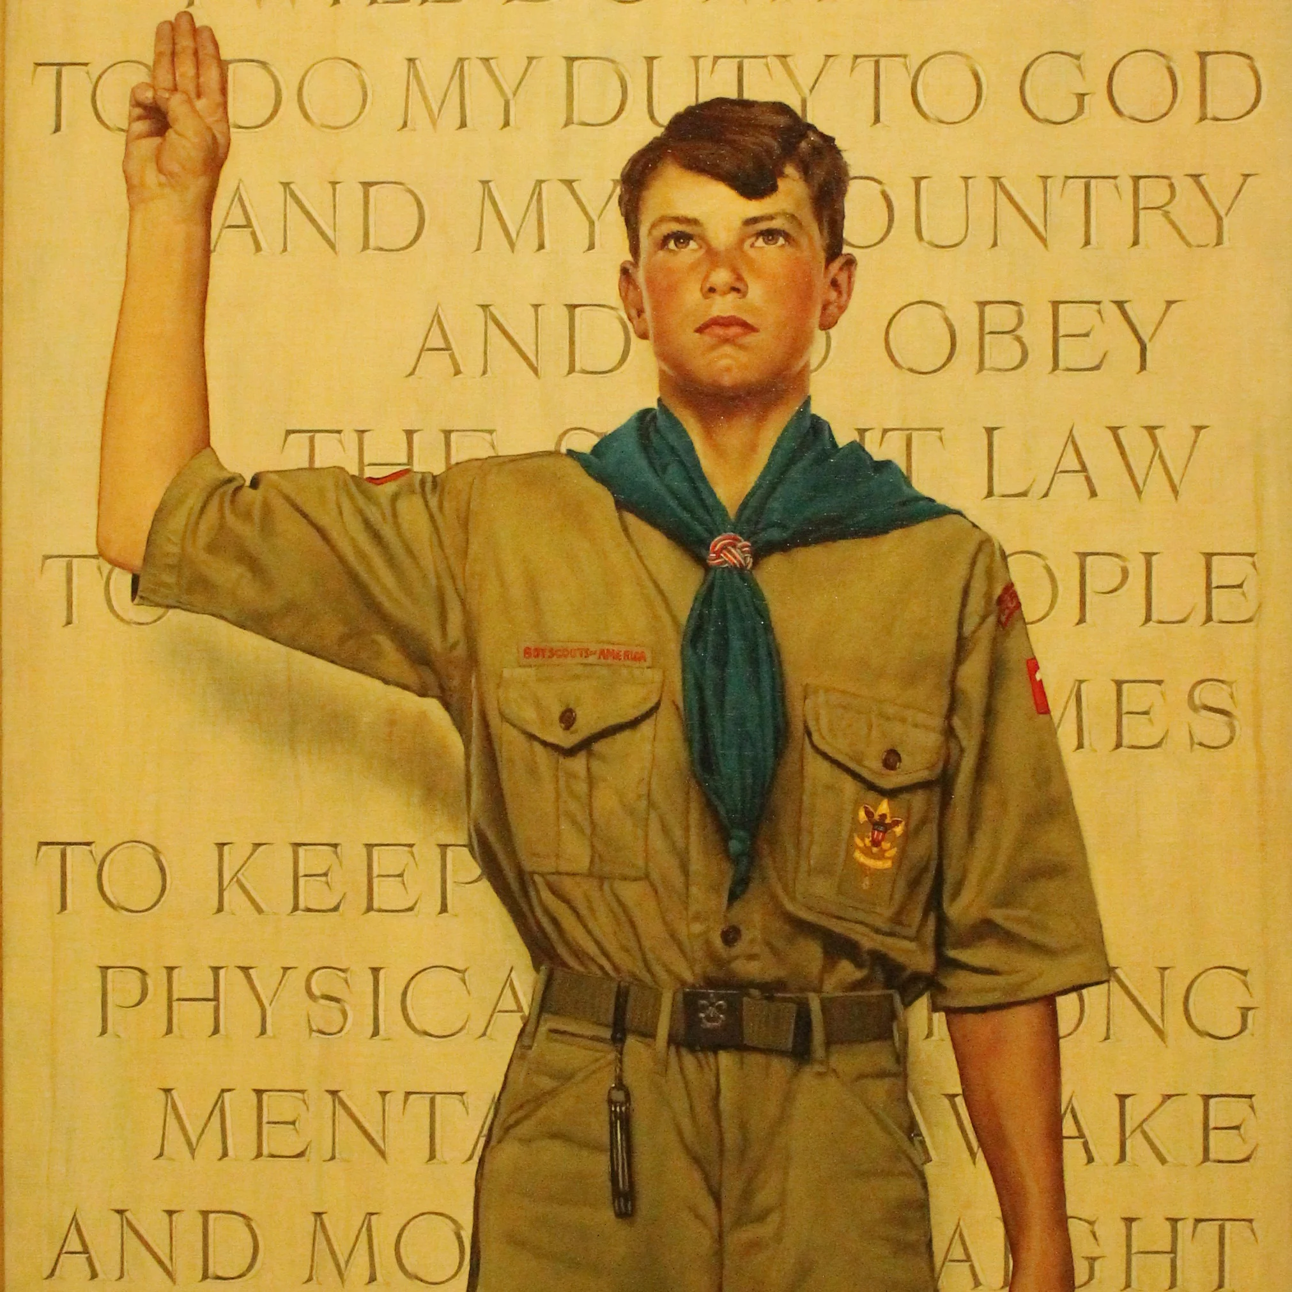
Duty to God
In the Scout Oath, every Scout has a duty to God.
  This means something different for every scout.
  Active involvement in your religion is important for your spiritual wellbeing.
  Religious principles you learn will help you to live by the Scout Law.

Slide 41

Socializing with Family and Friends
Spend quality time with your family and friends by helping to plan outings and activities.
  “Quality time” means sharing through communication and joint activities.
If you talk about common interest, work together on a project, plan for a special occasion, share a pleasant or meaningful experience, or play together, you are getting and giving healthy benefits through your activity.
Your family and friends can be your most important possessions.
How do you spend quality time with your family and friends in social and recreational activities?

Slide 42

Home Life
A good family life is essential to a healthy mind and body.
As a family member, your contributions are important to your family’s well-being.
Support family efforts for a peaceful and meaningful home life.
Just as your parents help you overcome your problems, you can help overcome some family problems.
How do you support family activities and efforts to maintain a good home life?

Slide 43
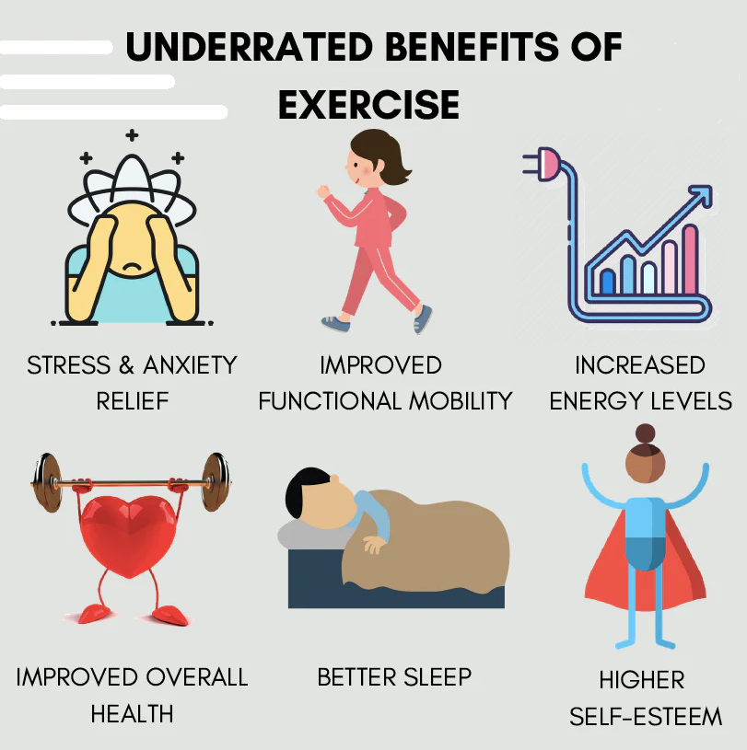
Requirement 4
Explain the following about physical fitness:
  The areas of physical fitness
  Your weakest and strongest area of physical fitness
  The need to have a balance in the four areas of physical fitness
  How a program like ScoutStrong can lead to lifelong healthful habits
  How the areas of personal fitness relate to the Scout Law and Scout Oath

Slide 44
Four Areas of Physical Fitness
Cardiovascular and Pulmonary Endurance
  Ability to maintain an activity that is aerobic (exercises that involve a large portion of body’s muscle mass and are continuous and rhythmic)
Muscular Strength and Endurance
  Strength - The ability of your muscles to contract and exert force against an opposing force.
  Endurance – The ability of your muscles to contract repeatedly or hold a condition against an opposing force.
Flexibility
  Joints range of motion
Body Composition
  Proportion of the body that is fat or muscle

Slide 45
Your Weakest and Strongest Areas of Physical Fitness
Return to Requirement 4b after completing the aerobic fitness, flexibility, and muscular strength tests, for Requirement 6.
Identify an area of personal fitness where you performed better than expected as well as an area that you could continue to improve.
What is your weakest and strongest area of physical fitness?
  Cardiovascular and Pulmonary endurance
  Muscular strength and endurance
  Flexibility
  Body composition

Slide 46
Balancing the Four Areas of Physical Fitness
A well-rounded approach to physical fitness emphasizes the importance of balance in the four key areas:
  Cardiorespiratory Endurance: Good cardiorespiratory fitness means you can perform sustained physical activities, like running or swimming, without becoming quickly fatigued. This fitness area is crucial for overall health and longevity, as a strong heart and lungs can reduce the risk of cardiovascular disease.
  Muscular Strength/Endurance: Both are crucial for daily tasks, from carrying groceries to climbing stairs. They also help maintain healthy bones and joints, improve body mechanics, and reduce the risk of injury.
  Flexibility: Good flexibility can improve your performance in physical activities and decrease your risk of injuries by helping your joints move through their full range of motion and enabling your muscles to work most effectively.
  Body Composition: Maintaining a healthy body composition, typically meaning a lower proportion of body fat, is important for overall health. High body fat percentages are linked to various health issues, including diabetes, hypertension, and heart disease.
Being balanced in all of these areas will help you to be prepared for a wide variety of physical challenges.

Slide 47

ScoutStrong Program
The SCOUTStrong PALA Challenge is a Scouting-specific version of the Presidential Active Lifestyle Award (PALA).
To earn the SCOUTStrong™ PALA Challenge award, a participant is required to meet a daily activity goal of:
  30 minutes per day for adults and 60 minutes a day for kids under 18 for at least five days a week, for a total of six weeks. Participants can take up to eight weeks to complete the program.
  Also, each week the participants will focus on a healthy eating goal.
Starting the SCOUTStrong PALA Challenge will help participants:
  Commit to daily physical activity—and stick with it.
  Commit to making healthier food choices—one goal at a time.
  Set realistic goals to encourage fitness and healthy eating habits for a lifetime.

Slide 48
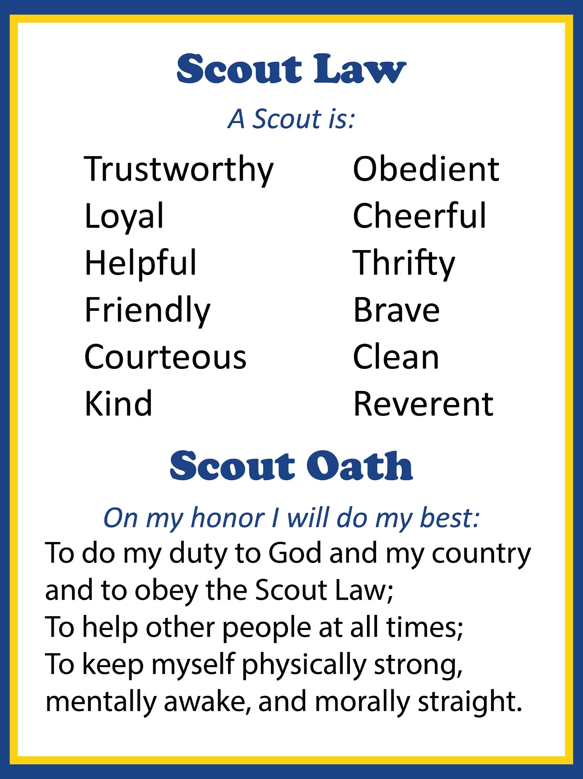
How Personal Fitness Relates to the Scout Oath and Scout Law
The Scout Oath speaks directly to the promise, “To keep myself physically strong.”
  This clearly refers to the importance of maintaining physical health and fitness as part of a Scout’s duty to themselves.
  Being fit also better equips Scouts “To help other people at all times,” fulfilling another aspect of the Scout Oath.

Slide 49
How Personal Fitness Relates to the Scout Oath and Scout Law
Personal fitness will also help you to carry out each point of the Scout Law:
  Trustworthy: Being physically fit can boost self-confidence and improve our mental state. This self-assuredness can foster trustworthiness, as you’re more likely to uphold promises to others and yourself, such as committing to a fitness regimen or a healthy lifestyle.
  Loyal: A fitness routine requires commitment and loyalty. By consistently following a fitness regimen, you’re not only loyal to your health but also setting an example of the dedication embodied in the Scout Law.
  Helpful: Physical fitness prepares you to lend a helping hand in situations requiring physical exertion, like community service projects or helping a neighbor with heavy lifting.
  Friendly, Courteous, and Kind: Participating in group fitness activities or team sports fosters social skills like friendliness, courtesy, and kindness.
  Obedient: Following a fitness program or coach’s instructions requires obedience, a direct application of this aspect of the Scout Law.

Slide 50
How Personal Fitness Relates to the Scout Oath and Scout Law
Personal fitness will also help you to carry out each point of the Scout Law (continued):
  Cheerful: Regular physical activity is known to boost mood and foster a cheerful disposition, thanks to the release of endorphins, often termed “feel-good hormones.”
  Thrifty: Regular physical activity and maintaining personal fitness can save on future health costs by preventing chronic diseases related to sedentary lifestyle.
  Brave: Challenging oneself to achieve fitness goals, especially when they seem difficult, requires bravery.
  Clean: A good fitness regimen often goes hand-in-hand with proper hygiene and cleanliness.
  Reverent: Many find that physical activity provides a time for introspection, contemplation, and connection with nature, all of which can enhance a sense of reverence.

Slide 51

Requirement 5
Explain the following:
  The importance of good nutrition
  What good nutrition means to you
  How good nutrition is related to the other components of personal fitness
  How to maintain a healthy weight

Slide 52
Importance of Good Nutrition
Good nutrition is the cornerstone of a healthy lifestyle and has far-reaching effects on our overall well-being.
  Energy Levels: Nutrient-dense foods, particularly those high in complex carbohydrates and proteins, provide the energy our bodies need to function optimally.
  Cognitive Function: A well-balanced diet supports brain health. Omega-3 fatty acids, for instance, are crucial for cognitive function and memory.
  Weight Management: Balanced intake of macronutrients (carbohydrates, proteins, and fats) helps maintain a healthy weight, reducing the risk of obesity and associated health problems such as heart disease and diabetes.
  Bone and Muscle Health: Adequate intake of calcium and vitamin D is crucial for bone health, while protein supports muscle growth and repair.

Slide 53
Importance of Good Nutrition
Good nutrition is the cornerstone of a healthy lifestyle and has far-reaching effects on our overall well-being (continued).
  Immune System Function: Vitamins, minerals, and antioxidants are crucial for immune system function, helping to prevent illness and disease.
  Digestive Health: A diet rich in fiber helps maintain a healthy digestive system, preventing constipation and promoting a healthy gut microbiome.
  Mood Regulation: Certain nutrients, like complex carbohydrates, proteins, omega-3 fatty acids, and B vitamins, have been shown to influence mood and mental well-being.
Good nutrition is not about short-term dietary changes, but rather a long-term, balanced diet that includes a variety of different foods to provide all the essential nutrients our bodies need.
This is the key to maintaining good health, preventing chronic disease, and enhancing overall quality of life.

Slide 54
What Good Nutrition Means
Good nutrition is a deeply personal concept, shaped by individual needs, preferences, and experiences.
Here are some thoughts to consider:
  Balanced Eating: Good nutrition doesn’t mean eliminating entire food groups. It’s about incorporating a balanced mix of nutrients in your diet, ensuring you get enough proteins, carbohydrates, fats, vitamins, and minerals to support overall health.
  Hydration: Staying adequately hydrated is a vital part of good nutrition. This means drinking at least 2 liters of water daily. It not only supports overall health but also aids in digestion and promotes clear, healthy skin.
  Minimizing Processed Foods: Limit the intake of processed foods, which are often high in sodium, sugar, and unhealthy fats. Instead, opt for whole, unprocessed foods like fruits, vegetables, whole grains, lean proteins, and healthy fats.

Slide 55
What Good Nutrition Means
Good nutrition is a deeply personal concept, shaped by individual needs, preferences, and experiences.
Here are some thoughts to consider (continued):
  Smart Snacking: Snacking isn’t bad if done wisely. Replace processed snacks with healthier alternatives such as nuts and seeds, which are nutrient-dense and can keep you satiated.
  Eating the Rainbow: A colorful plate ensures a mix of different fruits and vegetables, which provide a range of essential vitamins, minerals, and antioxidants.
  Listening to Your Body: Good nutrition also means listening to your body’s hunger and fullness cues. Try to eat when you are truly hungry, not when you are bored or stressed.
In essence, good nutrition is not just about eating the right things but also adopting a balanced, mindful approach towards food and eating habits. It’s about making informed decisions that support overall well-being in a sustainable, enjoyable way.

Slide 56
How Good Nutrition Is Related to Personal Fitness
Components of Personal Fitness | How Good Nutrition Helps
Cardiorespiratory Fitness | Adequate hydration and balanced macronutrient intake (proteins, carbs, fats) support cardiovascular health and energy levels necessary for cardio activities.
Muscular Strength and Endurance | Protein is essential for muscle recovery and growth, while carbohydrates provide the energy needed for strength training and muscular endurance exercises.
Flexibility | Proper nutrition, including adequate hydration and micronutrients like magnesium and Vitamin D, helps maintain the health of connective tissues, enhancing flexibility.
Body Composition | A balanced, calorie-controlled diet influences body fat and muscle mass percentages, impacting overall body composition.

Slide 57
Nutritious and Balanced Diet
Eating a healthy, balanced diet is an important part of maintaining good health, and can help you feel your best.
This means eating a wide variety of foods in the right proportions, and consuming the right amount of food and drink to achieve and maintain a healthy body weight.
A healthy diet:
  Emphasizes fruits, vegetables, whole grains, and fat-free or low-fat milk and milk products
  Includes a variety of protein foods such as seafood, lean meats and poultry, eggs, legumes (beans and peas), soy products, nuts, and seeds.
  Is low in added sugars, sodium, saturated fats, trans fats, and cholesterol.
  Stays within your daily calorie needs

Slide 58

Nutritious and Balanced Diet
MyPlate Plan
  The MyPlate Plan shows your food group targets – what and how much to eat within your calorie allowance.
    Developed by the U.S. Department of Agriculture.
  Your food plan is personalized, based on your:
    Age
    Sex
    Height
    Weight
    Physical activity level
  To begin, click on the link below, and then click on the "Start" button.
  https://www.choosemyplate.gov/MyPlatePlan
  Once you have entered your data, you can download your personalized plan.

Slide 59
How to Maintain a Healthy Weight
Maintaining a healthy weight is a result of a balanced relationship between the calories you consume through food and drinks, and the calories you burn through physical activities.
Here are some key strategies for maintaining a healthy weight:
  Balanced Diet: Consuming a variety of foods from each food group will ensure you get a broad spectrum of nutrients. It’s important to incorporate fruits, vegetables, whole grains, lean proteins, and healthy fats in your diet.
  Portion Control: Being aware of serving sizes and not overeating, even when it comes to healthy food, is important. Too much of any food can lead to weight gain.
  Regular Exercise: The American Heart Association recommends 150 minutes of moderate-intensity aerobic activity or 75 minutes of vigorous aerobic activity per week, along with muscle-strengthening activities 2 or more days a week.

Slide 60
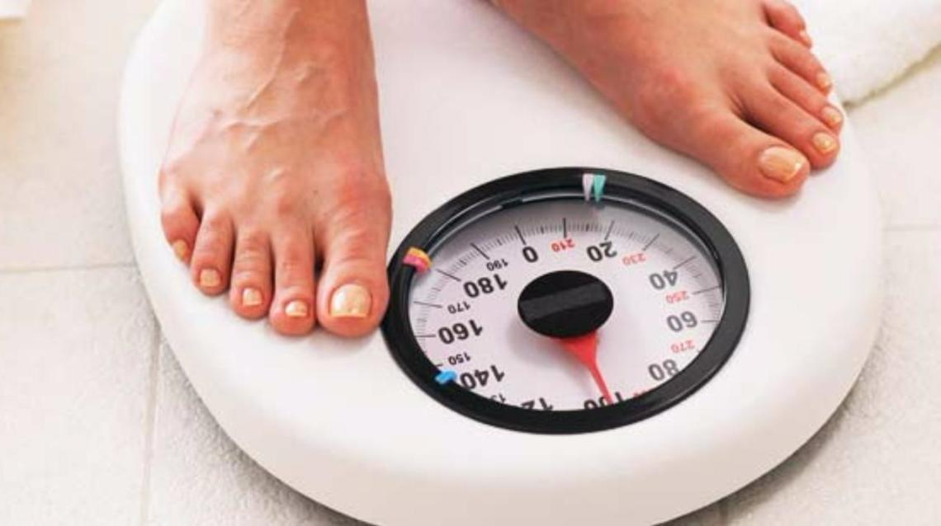
How to Maintain a Healthy Weight
Here are some key strategies for maintaining a healthy weight (continued):
  Regular Check-ups: Regular weight check-ups can help you keep track of your weight and spot any gains before they become a problem.
  Stay Hydrated: Drinking plenty of water is crucial for your health and can also help control hunger, as sometimes thirst is confused with hunger.
  Sleep Well: Lack of sleep can interfere with your body’s hunger hormones and could lead to weight gain.

Slide 61
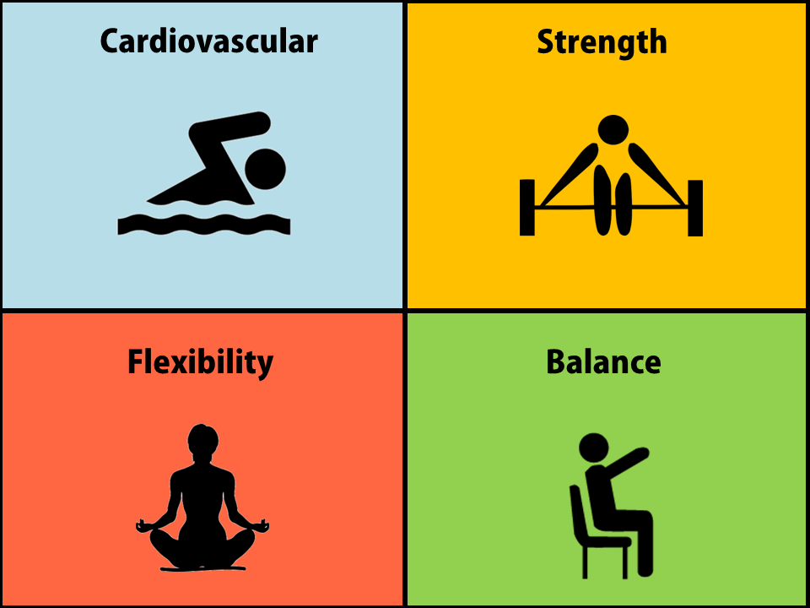
Requirement 6
Before doing requirements 7 and 8, do the following:
  Complete the aerobic fitness, flexibility, and muscular strength tests, as described in the Personal Fitness merit badge pamphlet. Record your results and identify those areas where you feel you need to improve.
  Keep track of what you eat and drink for three days. Identify three healthy eating goals you want to work on.

Slide 62
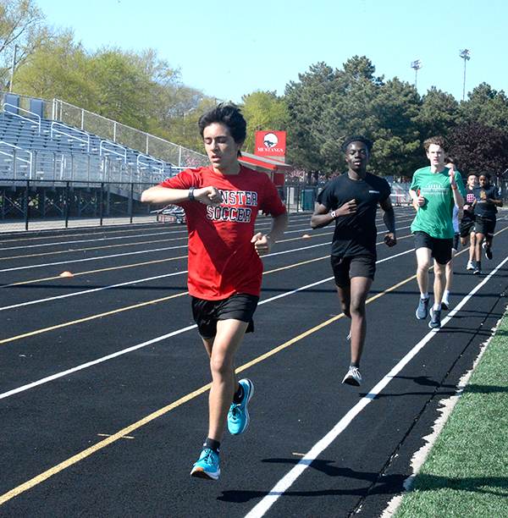
Physical Fitness Test
Aerobic Fitness Test:
  Record your performance on one of the following tests:
    Run/walk as far as you can as fast as you can in 9 minutes.
    Run/walk 1 mile (1600 meters) as fast as you can.

Slide 63
Physical Fitness Test
Flexibility Test:
  Using a sit-and-reach box (see next slide), make four repetitions and record the forth reach.
    You can improvise a similar device; such as a yardstick taped to a bench.
  To assume the starting position, remove your shoes and sit facing the box.
  Keep your knees fully extended and flat on the floor.
  Place your feet against the end board.
  You might need to have someone gently hold your knees flat on the floor.
  Extend your arms forward with your hands placed on top of each other, palms down.
  Bend at the hips (not curling the shoulders), reach forward along the measuring scale four times, and hold your hands at the maximum position on the measuring scale for the fourth reach.
  This test reach must be held steady for 15 seconds to qualify.
  Record the measurement of the 4th reach.

Slide 64
Physical Fitness Test
Making a Sit-and-Reach Device
Cut the following pieces using ¾” plywood
  Four 12” x 12” pieces
  One 12” x 21” piece
Assemble the pieces using wood screws and glue following the adjacent diagram.
Inscribe the top panel with 1 centimeter or half inch gradations.
It is crucial that the vertical plane against which the participant's feet will be placed is exactly at the 23 cm or 9 inch mark.
The measuring scale should extend from 0 at the front edge to 21 inches (53cm) at the far end.
Cover the apparatus with two coats of polyurethane sealer

Slide 65
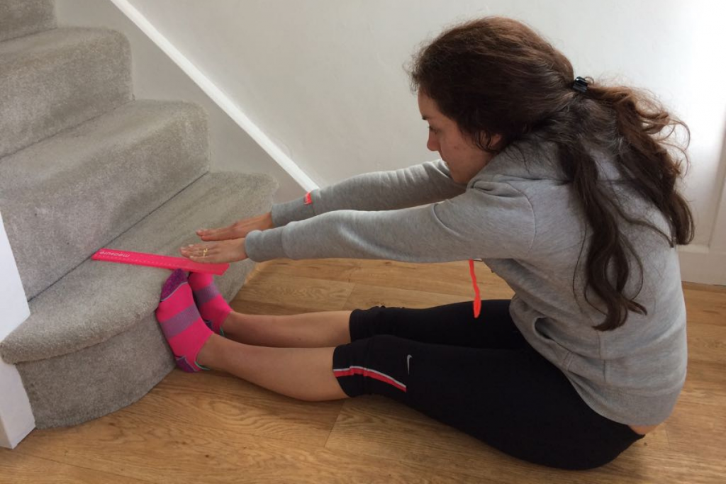
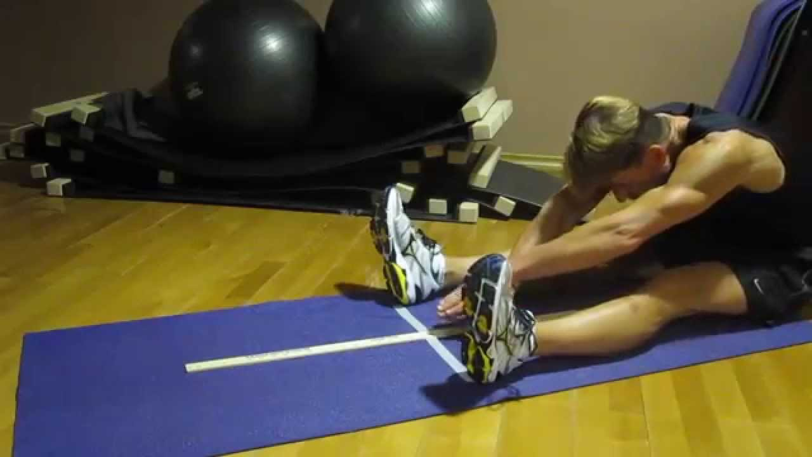
Improvising Sit and Reach Test

Slide 66
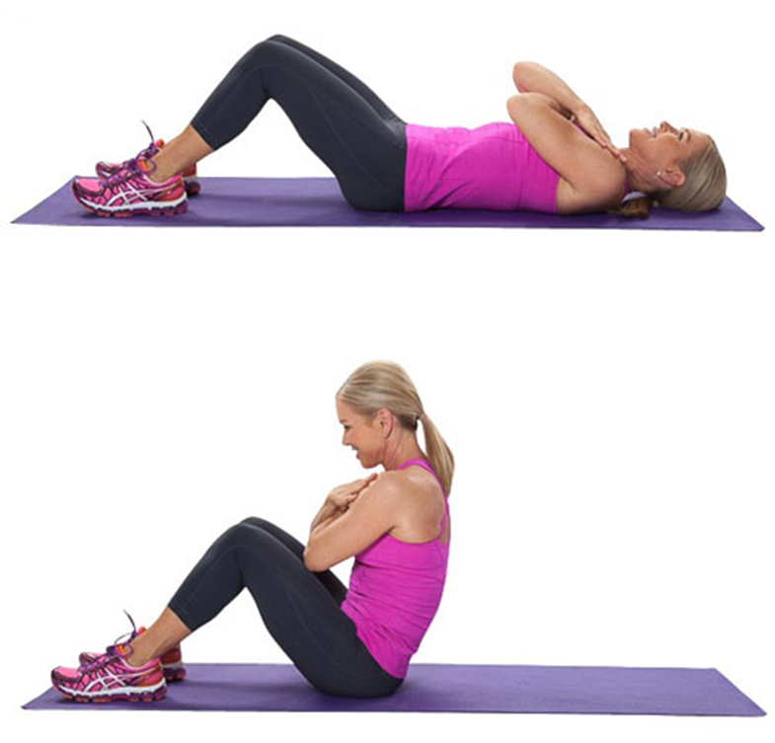
Physical Fitness Test
Strength Tests:
  Record your performance on all three tests.
    Sit-ups – Record the number of sit-ups done correctly in 60 seconds.
    To assume the starting position, lie on your back with knees flexed, feet on the floor, and heels between 12 and 18 inches from the buttocks.
    The arms are crossed on the chest with the hands on the opposite shoulders.
    The feet are held by a partner to keep them on the floor.
    Curl to the sitting position until the elbows touch the thighs.
    Arms must remain on the chest and chin tucked on the chest.
    Return to the starting position, shoulder blades touching the floor.

Slide 67
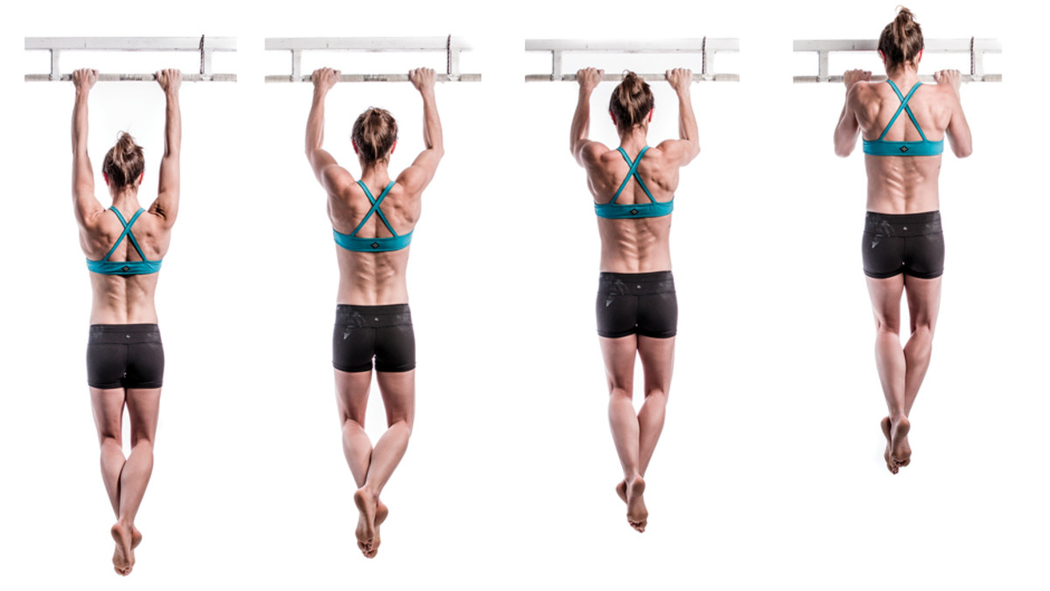
Physical Fitness Test
Strength Tests:
  Record your performance on all three tests.
    Pull-ups – Record the total number of pull-ups completed correctly in 60 seconds.
    Begin the exercise hanging from the bar with arms fully extended and hands on the bar, palms forward and directly above the shoulders.
    Pull up until you can touch the top of the bar with the bottom of your outstretched chin.

Slide 68
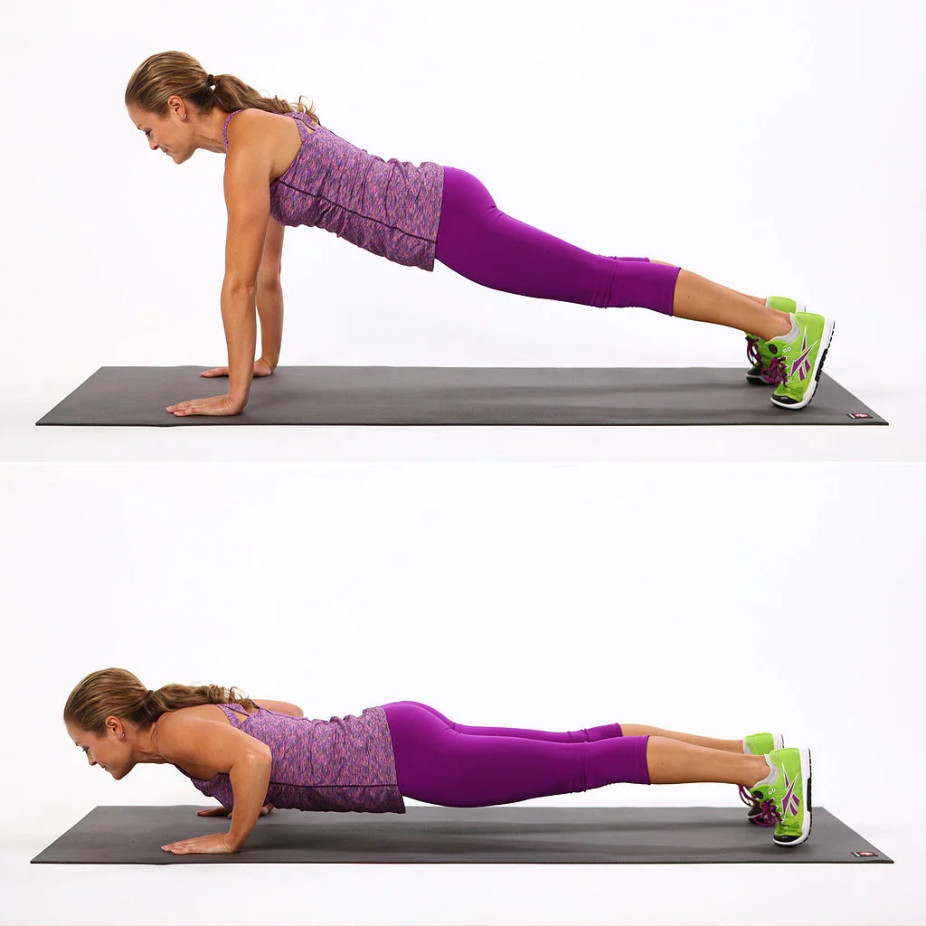
Physical Fitness Test
Strength Tests:
  Record your performance on all three tests.
    Push-ups – Record the total number of push-ups completed correctly in 60 seconds.
    Begin in a prone position on the floor with the palms flat on the floor under the shoulders.
    The feet are flexed up with the ball of the foot and the toes on the floor.
    Push up by fully extending the arms.
    Try not to lock the elbows.
    The shoulders, hips, and legs should remain in a straight line from the heels to the head.

Slide 69
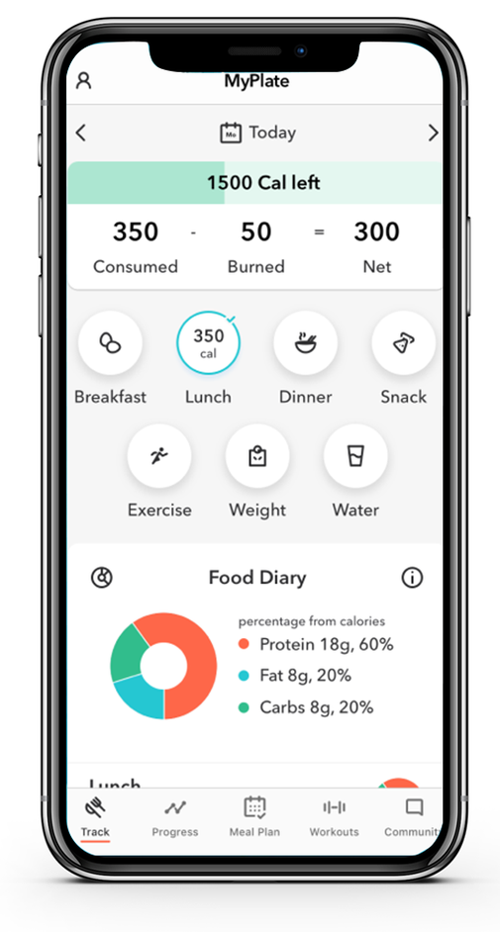
Tracking what You Eat and Drink
Record everything you eat and drink over a period of three days.
This includes main meals (breakfast, lunch, and dinner), snacks, and beverages.
Try to be as detailed as possible, including portion sizes and ingredients in your meals.
Use the Food Log on the next slide to help you keep track of what you eat and drink for three days.

Slide 70
Download the Food Log that accompanies this presentation.

Slide 71
Healthy Eating Goals
After tracking your diet for three days, review your meals and habits. Identify areas where you can improve and set three healthy eating goals to work on.
Here are some examples of possible goals:
  Increase water intake: If you find you’re not drinking enough water throughout the day, this could be a good goal. The exact amount varies depending on age, gender, and level of physical activity, but a general guideline is at least 8 cups (64 ounces) per day.
  Eat more fruits and vegetables: If your food diary shows that you’re not getting enough fruits and vegetables, you could aim to include at least one serving of fruits or vegetables with every meal.
  Reduce processed foods: If you notice that a large portion of your diet comes from processed foods (like chips, cookies, fast food, etc.), a good goal could be to reduce your consumption of these and replace them with whole foods.

Slide 72
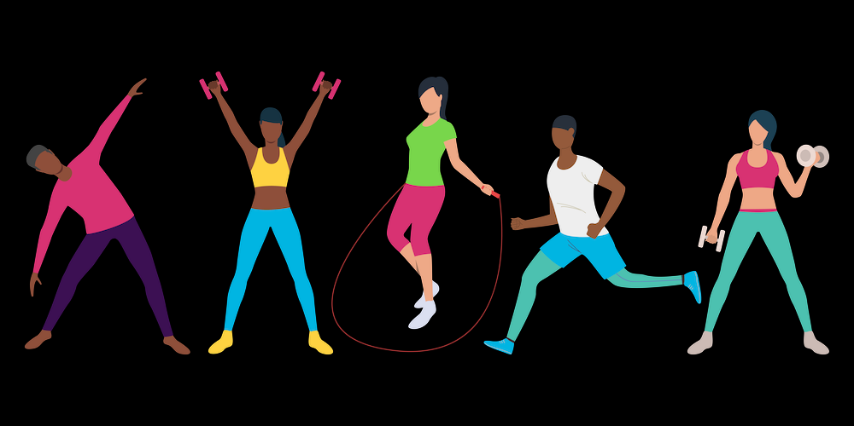
Requirement 7
Outline a comprehensive 12-week physical fitness program using the results of your fitness tests. Be sure your program incorporates the endurance, intensity, and warm-up guidelines discussed in the Personal Fitness merit badge pamphlet. Before beginning your exercises, have the program approved by your counselor and parents.

Slide 73
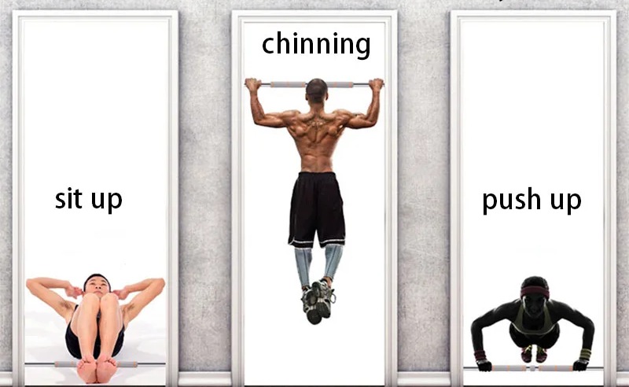
Endurance, Intensity, and Warm-up Guidelines
Muscular Strength/Endurance
  Start by seeing how many sit-ups, push-ups, and pull-ups you can do without stopping.
  Take 1/3 to 1/2 of that number and do that many sit-ups, push-ups, and pull-ups as a set. Do three sets, resting a minute or two between each set.
  Keep a progress record by testing yourself every week.
  Use the results from the second and fourth weeks to gauge your overall progress and to decide whether your exercise sets should be increased.
  As you get stronger, you need to do a greater number of repetitions and sets to continue to increase muscular strength.
  Once you achieve the strength you want to have, you can maintain it by doing your exercises just two or three times a week.

Slide 74

Endurance, Intensity, and Warm-up Guidelines
Monitoring Workout Intensity
  One way to monitor your workout intensity is to check your heart rate about five minutes after you start exercising.
  To check your pulse over your carotid artery, place your index and third fingers on your neck to the side of your windpipe.
  When you feel your pulse, look at your watch and count the number of beats in 15 seconds.
  Multiply the number of beats you count by four to get your heartbeat per minute.
  Your exercising heart rate should be between 125 and 170 beats per minute

Slide 75

Endurance, Intensity, and Warm-up Guidelines
Warm-up Guidelines:
  BSA recommends that you warm up before every workout with several minutes of low-intensity movement.
  Either jogging or jumping rope are great ways to get your blood flowing, but you can also swim or walk briskly if you’d prefer.
  Following the low-intensity warm-up, you should briefly stretch and loosen your muscles.

Slide 76
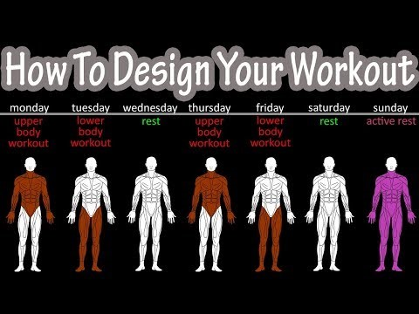
12 Week Physical Fitness Program
Creating Your Own Personal Fitness Program
Watch this short (4:37) video to learn the foundations of creating your own workout plan:
https://youtu.be/aY-jST9htEM

Slide 77
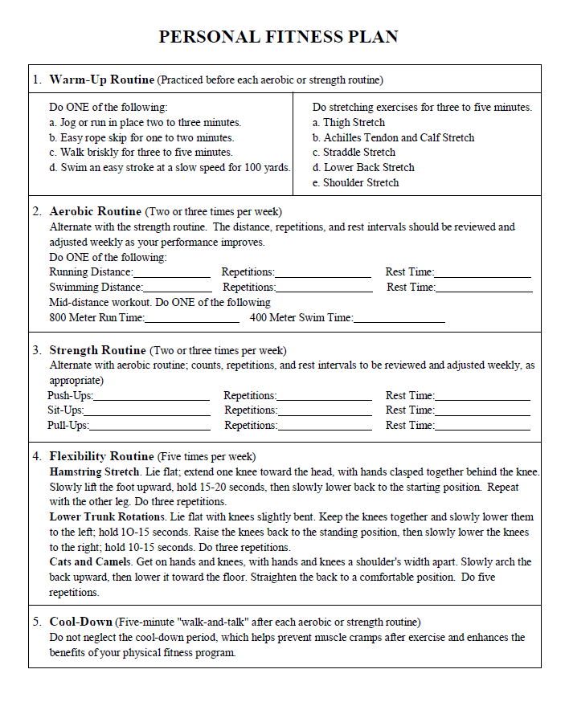
Download the Sample Personal Fitness Plan that accompanies this presentation.

Slide 78
Requirement 8
Complete the physical fitness program you outlined in requirement 7. Keep a log of your fitness program activity (how long you exercised; how far you ran, swam, or biked; how many exercise repetitions you completed; your exercise heart rate; etc.). Keep a log of your weekly healthy eating goals. Repeat the aerobic fitness, muscular strength, and flexibility tests every four weeks and record your results. After the 12th week, repeat all of the required activities in each of the three test categories, record your results, and show improvement in each one. Discuss how well you met your healthy eating goals over these 12 weeks. Discuss the meaning and benefit of your experience, and describe your long-term plans regarding your personal fitness.

Slide 79
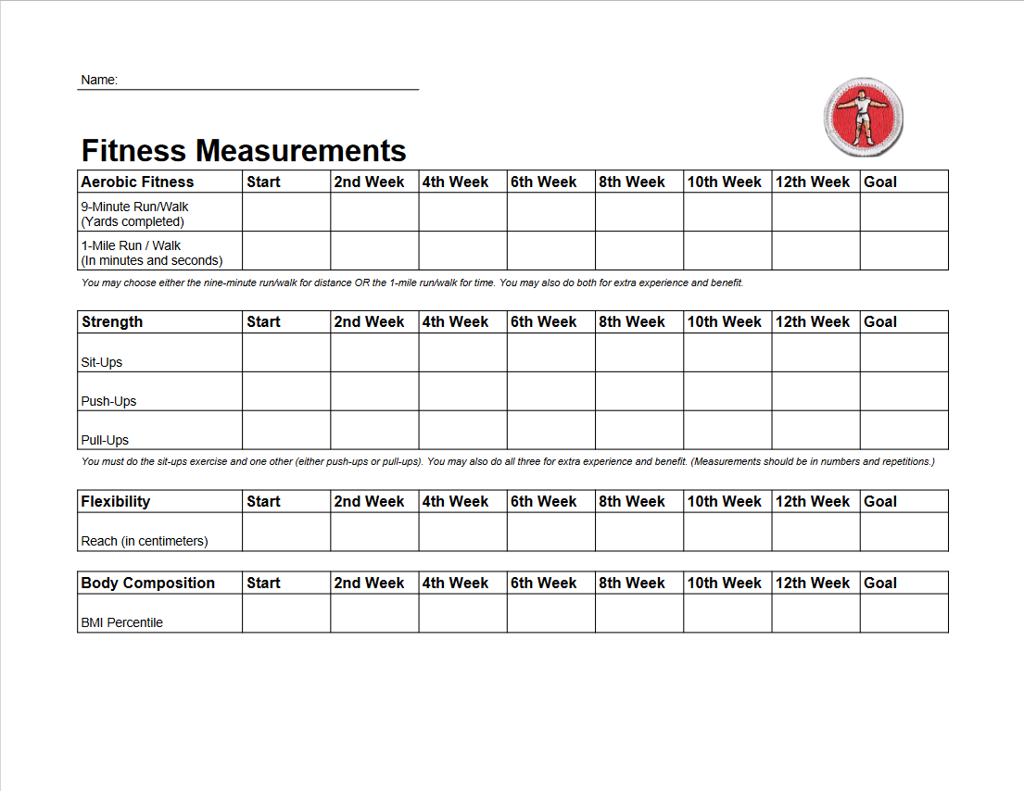
Download the Fitness Measurements Log that accompanies this presentation.

Slide 80
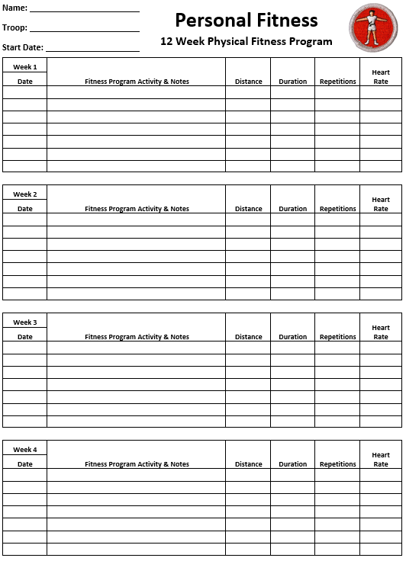
Download the 12 Week Physical Fitness Program Log that accompanies this presentation.

Slide 81
12 Week Physical Fitness Program
After 12 weeks, evaluate your progress against your initial fitness test.
  Find your percentile level on the various measurements (next four slides).
  How do you compare on both your beginning and final scores?
  How far up the scale did you progress after only three months of regular exercise?
Reflect on how well you met your eating goals, where you struggled, and where you succeeded.
Discuss the benefits you experienced, such as improved fitness levels, better mood, increased energy, and perhaps even weight loss.
Reflect on the meaning of these changes for you, such as improved self-esteem, discipline, commitment, or perseverance.
Based on your experience, what would you do differently in designing another fitness program for yourself?
Regarding your long-term plans, how can you incorporate what you’ve learned into your daily routine?
What new goals could you set to continue challenging yourself and improving your fitness?

Slide 82
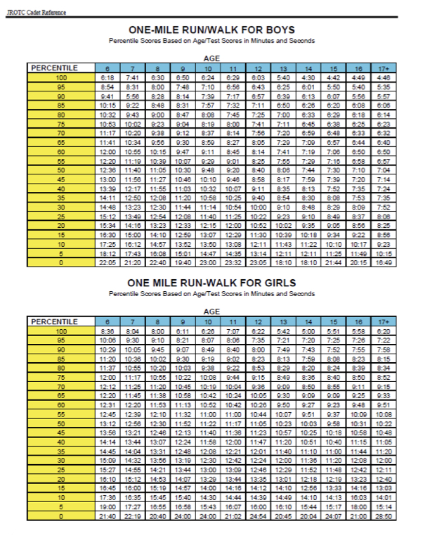
Physical Fitness Percentile Norms

Slide 83
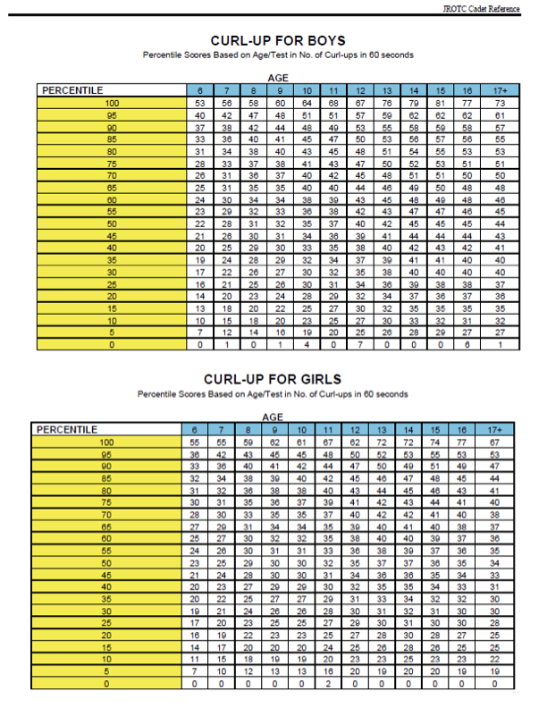
Physical Fitness Percentile Norms
SIT-UPS FOR BOYS
SIT-UPS FOR GIRLS

Slide 84
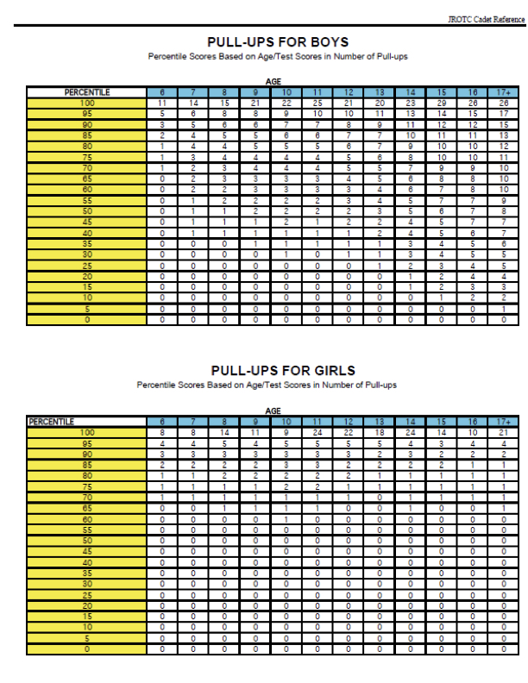
Physical Fitness Percentile Norms

Slide 85
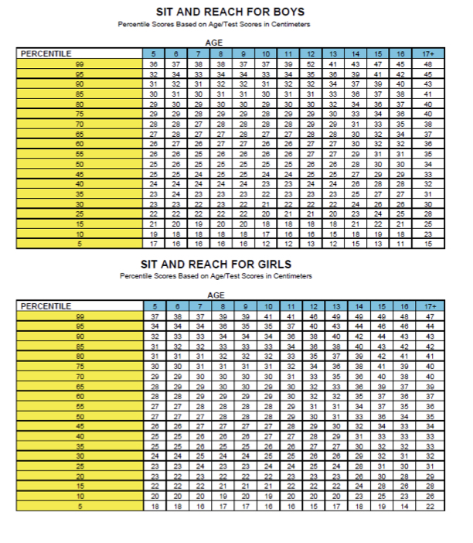
Physical Fitness Percentile Norms

Slide 86
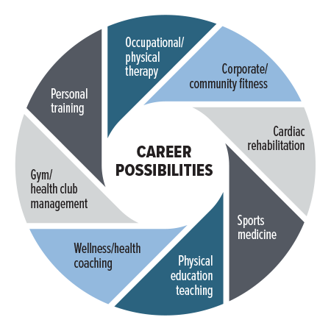
Requirement 9
Find out about three career opportunities in personal fitness. Pick one and find out the education, training, and experience required for this profession. Discuss what you learned with your counselor, and explain why this profession might interest you.

Slide 87
Careers in Personal Fitness
Certified Athletic Trainer – An athletic trainer works one-on-one with athletes in football, baseball, soccer, basketball and other sports at the high school, collegiate and professional levels. In addition to helping plan the team’s group fitness activities, they design fitness plans for each athlete on the team, depending on their fitness needs and injury history. They also provide sports medicine help for athletes, such as pre-practice and pre-game taping, post-game icing and rubdowns and physical therapy during injury recovery periods.
Dietician - A dietitian is knowledgeable about the dietary needs of anyone who makes fitness a large part of their life. They can inform and assist clients in developing meal plans based on their caloric output and recommend vitamins and supplements. Their work helps improve performance and manage weight so their clients can live a lifestyle that supports their fitness goals.

Slide 88
Careers in Personal Fitness
Fitness Apparel Designer - A fitness apparel designer has a wide range of daily responsibilities, such as planning and attending meetings with cross-functional teams, spying market trends, researching, sketching new designs and working out to gain firsthand experience on innovative technological trends for manufacturing fitness clothes. They are responsible for creating prototypes that are useful in solving different requirements regarding their clients' sportswear.
Fitness Tech Engineer - Designing fitness tech is all about finding solutions to real-world problems: smelly workout gear, finicky fitness trackers, and sore muscles. All that gear all is inspired by athletes—but it takes engineers to bring it to life. It is among the highest paying jobs in fitness because the job duty is to solve real-world situations due to a sedentary lifestyle. The engineers also research how current technologies affect their clients' fitness levels and then issue the recommended solutions.

Slide 89
Careers in Personal Fitness
Group Fitness Instructor - A group fitness instructor usually works in a gym to instruct groups of people. They develop fitness programs for classes such as Zumba, yoga and strength training and motivate individuals in the class. Group fitness instructors could also teach different difficulty levels of each class and adjust the programs accordingly.
Health and Wellness Coach - A health coach assesses, evaluates and helps improve their clients' health. Health coaches conduct initial evaluations of an individual's health and make recommendations that encourage the adoption of health-based behaviors and choices. A health coach designs and implements personalized health plans for their clients. They also conduct follow-up meetings with clients to ensure they remain on track and meet their goals.

Slide 90
Careers in Personal Fitness
Kinesiologist - A kinesiologist tests muscles and develops treatment plans to improve their function. They may be able to identify sources of stress, also known as imbalances in structural, chemical and emotional energy, in the body and provide rehabilitation to eliminate them. Kinesiologists can work in a variety of settings, including offices, laboratories, recreation facilities, hospitals, schools, and residential facilities. They work for organizations that develop and implement fitness plans for individuals or that study human movement.
Orthopedic Surgeon - Orthopedic surgeons specialize in the tendons, bones, ligaments, muscles and joints of the body and treat sports-related injuries. They operate on musculoskeletal body systems to correct injuries so an athlete can maintain their ability in their sport.

Slide 91
Careers in Personal Fitness
Personal Trainer - A certified personal trainer is an accredited expert in fitness training and exercise. They use their knowledge and experience to help their clients achieve their health and fitness goals. They assess their client's current physical conditioning and develop exercise and nutrition plans according to specific goals.
Physical Education Teacher - A physical education (PE) teacher works in a school setting to educate students about the importance of physical fitness and health-based lifestyle choices. Their curriculum can include team sports, exercise activities and competitions. They coach sports teams at the school and develop individual exercise lessons as needed. Physical education teachers also make sure that students understand what teamwork, sportsmanship and cooperation mean.

Slide 92
Careers in Personal Fitness
Physical Therapist - Physical therapists are experts in the proper movement and function of the human body. They assist their patients in the recovery from diseases, injuries and surgeries. Physical therapists examine patients and understand their case history and rehabilitation goals. They also design and implement treatment plans to help reduce pain, increase joint and muscle health and prevent further injury.
Sports Medicine Physician - Sports medicine physicians provide care to athletes and fitness professionals. In addition to providing basic care, such as yearly checkups, they may also help with injury prevention, nutrition and rehabilitation, as well as prescribe medication as needed. Sports medicine physicians work alongside physical therapists and athletic trainers to provide well-rounded treatment.

Slide 93


